Slide 1
English Stylistics
Week 5
Rhetorical devices

Slide 2
Review (Week 4)
Nouns in different lexical sets
Verbs of different types (transitive vs. intransitive)
Germanic vs. Latinate words in English

Slide 3
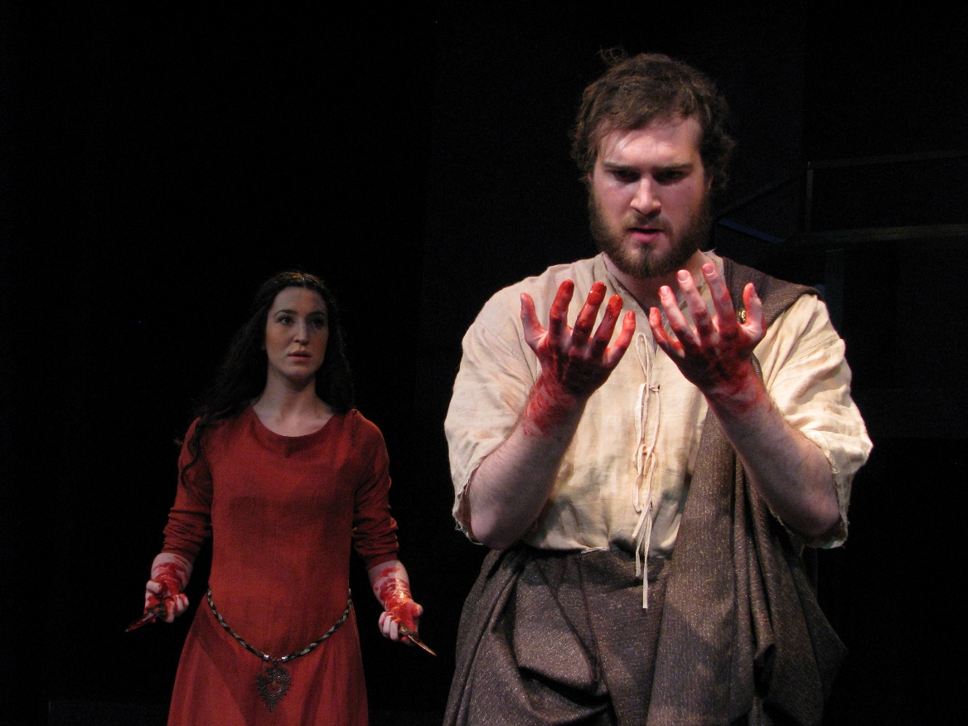
A line in the Scottish play

Slide 4
In-class reading (Text 13-A and 13-B)
Calculate the ratio of Germanic – Latinate words in the two texts, and consider the effect of such lexical choices.
http://etymonline.com/

Slide 5
Formal vs. Less formal correspondence
 | Text A | Text B
Latinate words (total) | 25% (33/133) | 16% (19/122)
Multisyllabic Latinate words | 8% (10/133) | 4% (5/122)

Slide 6
In today’s class
Rhetorical devices in English

Slide 7
Rhetorical devices
→ Meaning transference
→ Meaning extension & contraction
→ Overstatement & understatement
→ Contradiction in logic
Effect: dramatic, persuasive, humorous, expressive, etc.

Slide 8
Rhetorical devices
Simile 明喻 Metaphor 暗喻
metonomy 转喻 Synecdoche 提喻
Hyperbole 夸张 Litotes 反叙/曲语
Oxymoron 逆喻
Antithesis 反衬 & Parallelism 排比

Slide 9
Other rhetorical devices (not covered)
Alliteration
Onomatopia
Anticlimax
Zeugma
…

Slide 10
Meaning through comparison
Overt comparison – simile
Covert comparison – metaphor

Slide 11
From As You Like It by Shakespeare
All the world's a stage,
And all the men and women merely players:
They have their exits and their entrances;
And one man in his time plays many parts
His acts being seven ages.

Slide 12
Meaning through extension
Metonymy (sth. related) … 转喻
Synecdoche (a part for the whole) … 提喻

Slide 13
Metonomy
→ The oval office is busy at work.
→ Let me give you a hand.
→ The pen is mightier than the sword.

Slide 14
Synecdoche
→ Many hands make light work.
→ Here come two black suits.

Slide 15
Overstatement: Hyperbole
→ This bag weighs a ton.
→ You could have knocked me over with a feather.

Slide 16
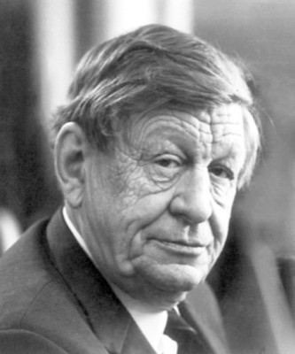
As I walked one evening (by W. H. Auden)
I’ll love you, dear, I’ll love you
Till China and Africa meet,
And the river jumps over the mountain
And the salmon sing in the street,

Slide 17
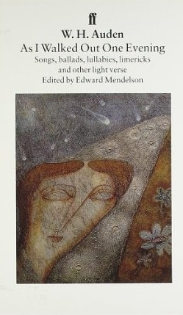
I’ll love you till the ocean
Is folded and hung up to dry
And the seven stars go squawking
Like geese about the sky.

Slide 18
Understatement: Litotes
With a subtle emphasis or irony
→ Not unlike … (like)
→ She is not as young as she was.
→ I’m not a little upset.

Slide 19
Contradiction in logic: Oxymoron
A combination of contradictory/incongruous words
→ Cruel kindness
→ A victorious defeat
→ Writing is busy idleness.

Slide 20

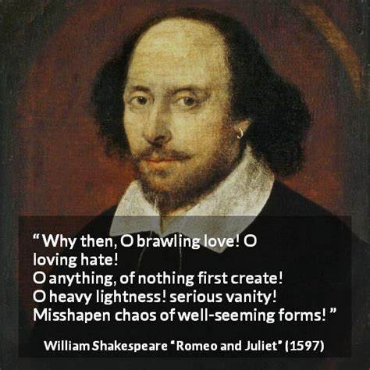
In-class reading: Text 14

Slide 21
Chinese translations:
“啊，吵吵闹闹的相爱，亲亲热热的怨恨！ 啊，无中生有的一切！ 啊沉重的轻浮，严肃的狂妄，整齐的混乱，铅铸的羽毛，光明的烟雾，寒冷的火焰，憔悴的健康，永远觉醒的睡眠，否定的存在！” （朱生豪）
“吵闹的爱呀！亲爱的仇！啊任何事物！真是无中生有。啊沉重的轻浮！严肃的虚妄！匀称的体形之歪曲的混乱！铅铁铸成的羽毛，亮的烟，冷的火，病的健康！永远醒着的睡眠，名实全然不符！（梁实秋）

Slide 22
Parallelism
The repetition of the same or similar structure
Rhythm, balance, force of persuasion
Text 15-16

Slide 23
Antithesis
the rhetorical contrast of ideas by means of parallel structures
→ Many are called, but few are chosen.
→ Man proposes, God disposes.
→ To err is human, to forgive divine.

Slide 24
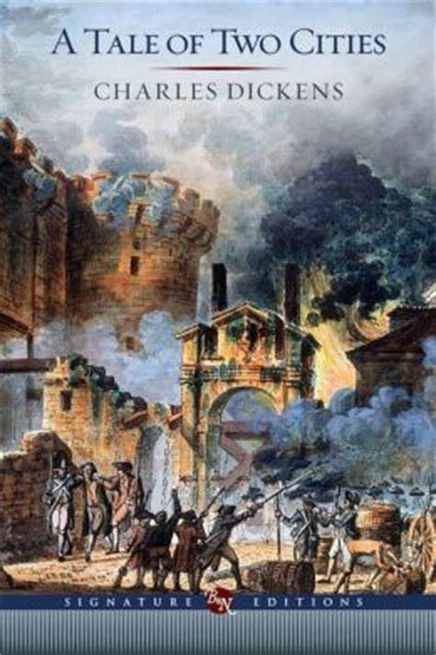
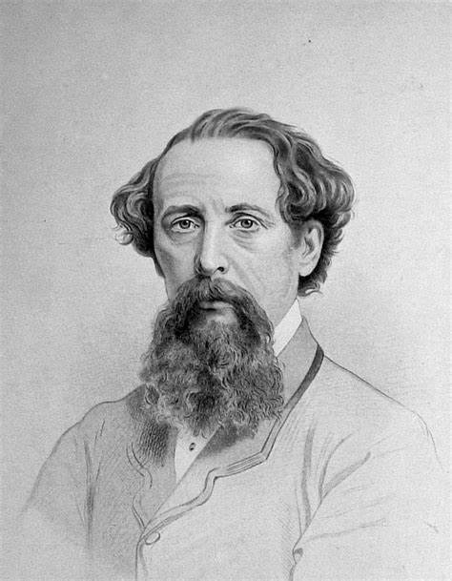
In-class reading: Text 17

Slide 25
Rhetorical devices
Simile 明喻 Metaphor 暗喻
metonomy 转喻 Synecdoche 提喻
Hyperbole 夸张 Litotes 反叙/曲语
Oxymoron 逆喻
Antithesis 反衬 & Parallelism 排比

Slide 26
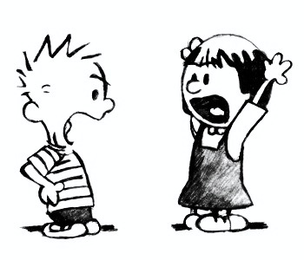
In-class exercises
Handout
10 minutes

Slide 27
Exercise
(1) The moon was a crescent, thin and sharp as the blade of a knife.
(2) The case was defended by eloquent lips.
(3) They came to live under the same roof.
(4) “Friends, Romans, Countrymen, lend me your ears” (Julius Caesar)
(5) We have 20,000 hungry mouths to feed.

Slide 28
Exercise
(6) That new car costs a bazillion dollars.
(7) Theomore is all head and no heart.
(8) “The assassin was not unacquainted with danger.”
(9) O Brawling love, O loving hate!
O heavy lightness, O serious vanity!
(10) Peace is the pearl beyond price.

Slide 29
Exercise
(11) Rhaegar fought valiantly, Rhaegar fought nobly, Rhaegar fought honorably. And Rhaegar died.
(12) The Umbers may seem simple, but they are not without a certain low cunning.
(13) They would not love me living, so let them dread me dead.
(14) Summer friends will melt away like summer snows, but winter friends are friends forever.

